Slide 1
KS2 Statistics Reasoning Practice
Timetables
Graphs
Pictograms
Tables
Pie charts

Slide 2
Reading and interpreting graphs

Slide 3
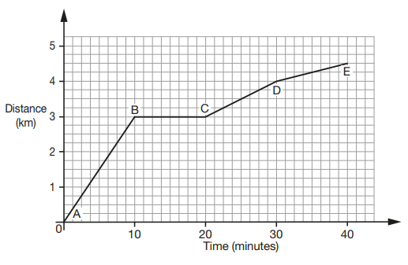
Graphs 1:
This graph shows the distance walked on a family hike.
1. How far did the family walk in total?
2. What happened between 10 and 20 minutes?
3. How far did the family walk in the first half of their walk?
4. How far, approximately, had the family walked in 35 minutes?
5. Between which two letters had the family walked the furthest distance?

Slide 4
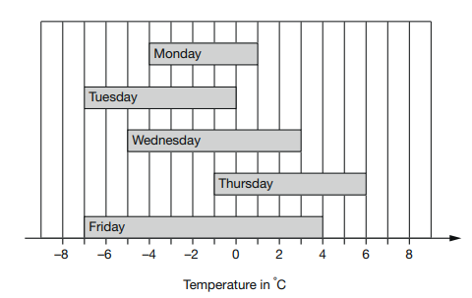
Graphs 2:
This graph shows the range of temperatures in a city in one week.
1. Which day had the highest temperature?
2. Which days had the lowest temperature?
3. What is the difference between the highest and lowest temperatures?
4. Which day did the temperature range the most?
5. On how many days did the temperature rise above 3˚C?

Slide 5
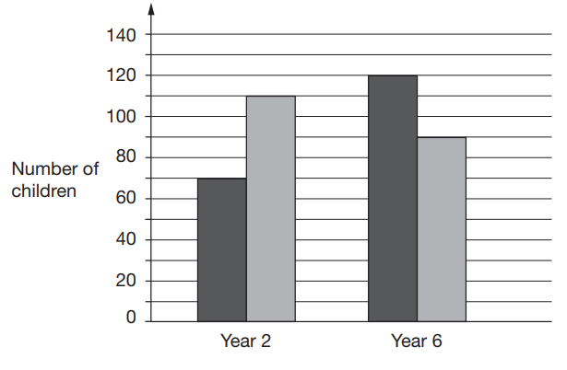
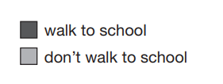
Graphs 3:
This graph shows the number of children who have siblings and don’t have siblings in Year 2 and Year 6.
1. How many children in Year 2 have siblings?
2. How many children in Year 6 don’t have siblings?
3. What is the difference between the number of children in Year 6 and in Year 2?
4. How many children are there altogether?
5. How many more children in Year 6 have siblings than in Year 2?
Have siblings
Don’t have siblings

Slide 6
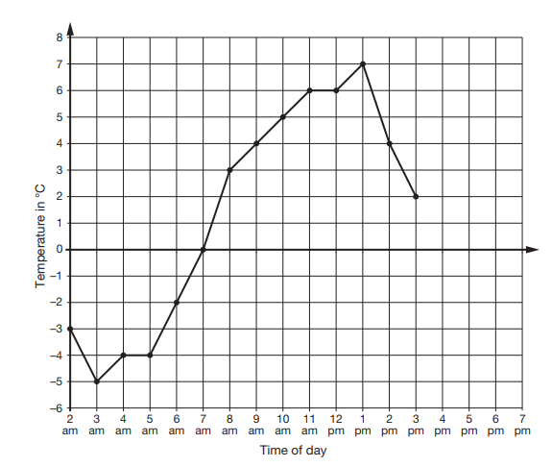
Graphs 4:
This graph shows the temperature every hour on a cold day.
1. At what time was it the coldest?
2. What was the temperature at 8am?
3. What was the temperature at 6:30am?
4. What is the difference between the coldest and warmest temperature?
5. The temperature fell 4 degrees by 4pm. Draw this on the graph.

Slide 7
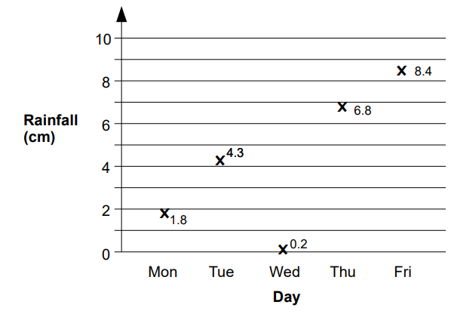
Graphs 5:
This graph shows the amount of rainfall over a week.
1. On which day did it rain the most?
2. Which day did it rain the least?
3. How much more did it rain on Tuesday than Monday?
4. What is the difference in rainfall between the wettest and driest day?
5. What is the mean rainfall over the 5 days?

Slide 8
Graphs (answers)
 | Graphs 1 | Graphs 2 | Graphs 3 | Graphs 4 | Graphs 5
Q1 | 4.5km | Thursday | 70 | 3am | Friday
Q2 | They stopped walking (or similar) | Tuesday and Friday | 90 | 3˚C | Wednesday
Q3 | 3km | 13˚C | 30 | -1˚C | 2.2cm
Q4 | 4.25km | Friday | 390 | 12˚C | 8.2cm
Q5 | A and B | 2 | 50 | Line drawn at -2˚C | 4.3cm

Slide 9
Reading and interpreting pictograms

Slide 10
This pictogram shows the number of cars parked in a car park over a week.
1. How many cars were parked on Monday?
2. What is the difference between the number of cars on Monday and Thursday?
3. 15 cars were parked on Wednesday. Draw this on the pictogram.
4. What is the total number of cars parked over the week?
5. If 70 cars were parked over the entire week, how many cars were parked in the car park on Friday?
= 6 cars
Mon Tues Weds Thurs

Slide 11
This pictogram shows the number of apples eaten by children in a month.
1. Susie ate 2 more apples than Ellie. Show this on the pictogram.
2. Who ate the most apples in a month?
3. Who ate the least apples?
4. What is the total number of apples eaten over the month?
5. If apples come in bags of 6, how many full bags of apples did the children eat in the month?
= 8 apples
Jack Ben Susie Ellie

Slide 12
This pictogram shows the number of apples eaten by children in a month.
1. How many ice creams were sold in July?
2. How many ice creams were sold in August?
3. In September, only 25 ice creams were sold. Show this on the pictogram.
4. What is the total number of ice creams eaten over the months?
5. What is the mean number of ice creams sold?
= 50 ice creams
June July August September

Slide 13
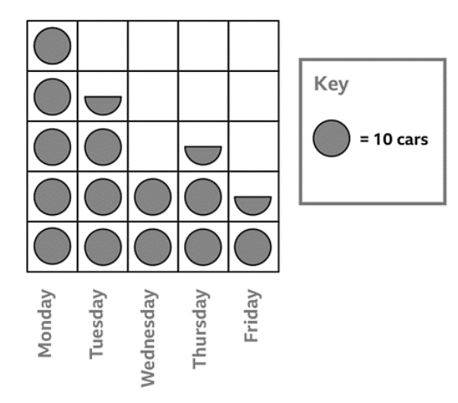
This pictogram shows the number of cars parked in a car park over a week.
1. How many cars were parked on Monday?
2. What is the difference between the number of cars on Monday and Thursday?
3. There were 10 more cars parked on Wednesday than Friday. Complete the pictogram to show this.
4. What is the total number of cars parked over the week?
5. If each car pays £3 to park. How much money did the car park make this week?

Slide 14
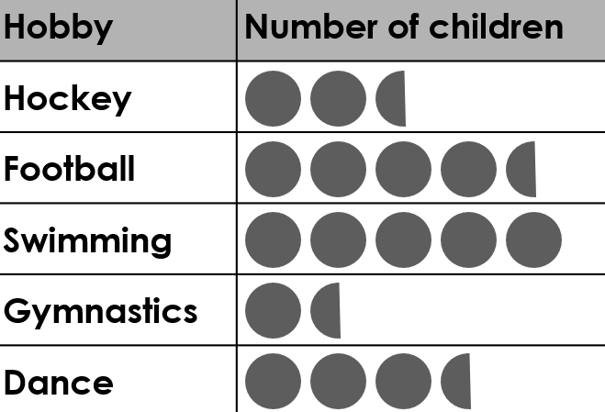
This pictogram shows the favourite hobbies of children in KS2.
1. If 30 children chose swimming, what does one circle represent?
2. Which hobby was the least popular?
3. How many more children chose dance than gymnastics?
4. What is the difference between children who like swimming and children who like hockey?
5. What is the total number of children asked?

Slide 15
Pictograms (answers)
 | Pictograms 1 | Pictograms 2 | Pictograms 3 | Pictograms 4 | Pictograms 5
Q1 | 18 | Three quarters of a circle added to Susie | 100 | 50 | 6
Q2 | 9 | Jack | 125 | 25 | Gymnastics
Q3 | One and a half circles drawn added to Wednesday. | Ellie | Half a triangle added to August | Half a circle added to Wednesday. | 12
Q4 | 54 | 64 | 300 | 150 | 15
Q5 | 16 | 10 | 125 | £450 | 102

Slide 16
Reading and interpreting timetables

Slide 17
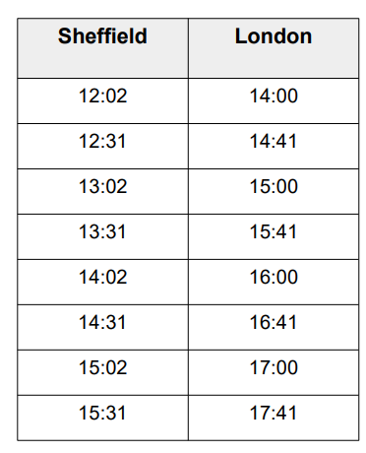
Timetables 1:
This is a train timetable showing the journey from Sheffield to London.
1. How long does the 12:02 take to get to London?
2. If I want to be in London by 15:50, what time do I have to be on the train from Sheffield?
3. I arrive at Sheffield station at 12:37. How long do I need to wait at the station for the next train?
4. The 13:31 train is delayed by 42 minutes. What time will it arrive in London for?
5. The 16:41 train from London arrives 23 minutes late. What time must it have left Sheffield?

Slide 18
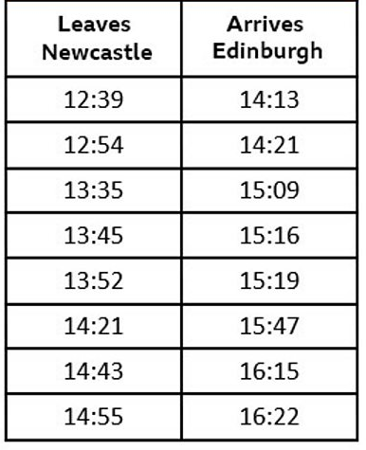
Timetables 2:
This is a train timetable showing the journey from Newcastle to Edinburgh.
1. How long does the 12:39 take to get to Edinburgh?
2. I have a meeting which starts at 3pm in Edinburgh, what time do I have to be on the train from Newcastle?
3. Which train between 1pm and 2pm is the fastest?
4. The 14:43 train is delayed by 18 minutes. What time will it arrive in Edinburgh?
5. Which train is faster: the 12:39 or the 14:21? By how much?

Slide 19
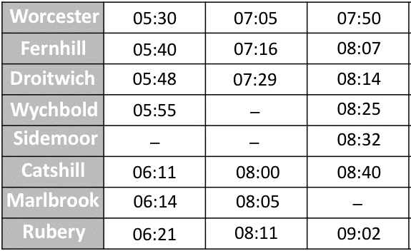
Timetables 3:
This table shows some bus times from Worcester to Rubery on a morning.
1. What time does the 05:40 from Fernhill arrive in Catshill?
2. My friend lives in Sidemoor. I live in Worcester. What is the earliest I can get on the bus?
3. How long do I need to wait at Droitwich for the next bus if I get there at 07:48am?
4. I need to be in Rubery by 9am. What time do I need to board the bus at Fernhill?
5. Which journey from Fernhill to Rubery is the fastest? Circle the fastest journey.

Slide 20
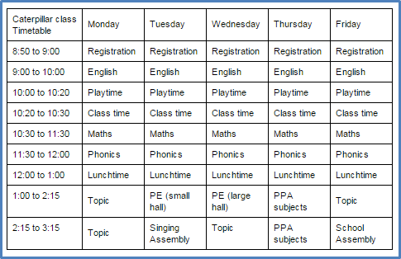
Timetables 4:
This timetable shows the weekly timetable of a class.
1. How much time do the class spend learning Maths every week?
2. How much time do the class get doing PE each week?
3. What is the total hours spent in assemblies in a week?
4. Do the children spend more time in Topic lessons or English?
5. How much time on Wednesday do the children spend NOT learning Maths or English?

Slide 21
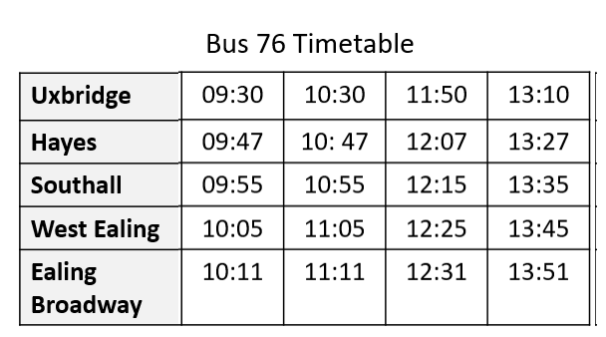
Timetables 5:
This timetable shows some bus times from Uxbridge to Ealing Broadway.
1. How long does the journey from Uxbridge to Hayes take?
2. I want to be in Southall by 11am. What time do I need to get on a bus from Hayes?
3. I’m in West Ealing at 11:58. How long do I have to wait for the next bus?
4. The 13:27 from Hayes is delayed by 14 minutes. What time will it arrive at Ealing Broadway?
5. Does the journey from West Ealing to Ealing Broadway always take the same amount of time?

Slide 22
Timetables (answers)
 | Timetables 1 | Timetables 2 | Timetables 3 | Timetables 4 | Timetables 5
Q1 | 1 hour 52 mins | 1 hour 34 mins | 06:11 | 5 hours | 17 mins
Q2 | 13:31 | 12:54 | 07:50 | 2 hours 30 mins | 10:47
Q3 | 25 mins | 13:52 | 26 mins | 2 hours | 27 mins
Q4 | 16:23 | 16:33 | 07:16 | English | 14:05
Q5 | 14:53 | 14:21 | 05:40 circled | 2 hours 45 mins | Yes - 6 mins

Slide 23
Reading and interpreting pie charts

Slide 24
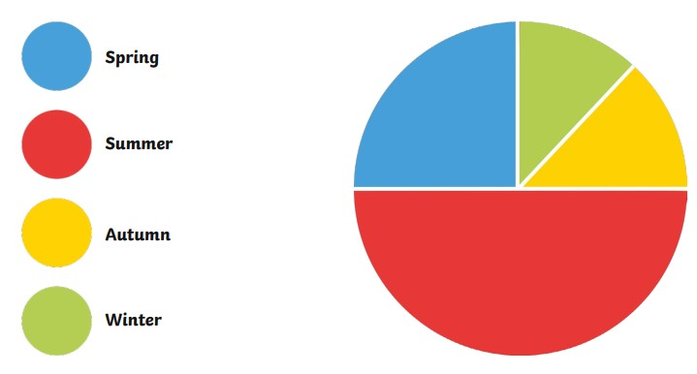
Pie chart 1:
This pie chart shows the favourite seasons of 120 children.
1. Which season was the most popular?
2. How many children chose Spring?
3. How many more children chose Summer than Autumn?
4. What percentage of children chose Autumn?
5. How many children did NOT choose Winter?

Slide 25
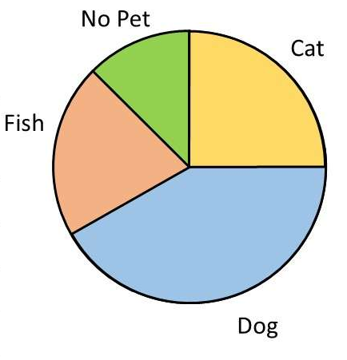
Pie chart 2:
This pie chart shows which pets children have.
1. Which category was the most common?
2. Which category was the least common?
3. If 80 children were asked, how many children have a cat?
4. What fraction of children have a cat?
5. Approximately, how many children have a fish?

Slide 26
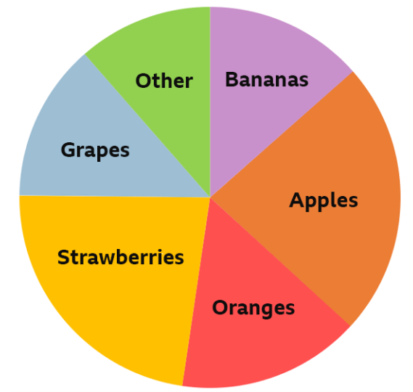
Pie chart 3:
This pie chart shows the results of 40 children when they were asked their favourite fruits.
1. Which fruit was the most popular?
2. How many children chose apples as their favourite fruit?
3. What fraction of children chose bananas as their favourite fruit?
4. True or false: 6 children chose grapes.
5. Approximately what percentage of children chose bananas and apples?

Slide 27
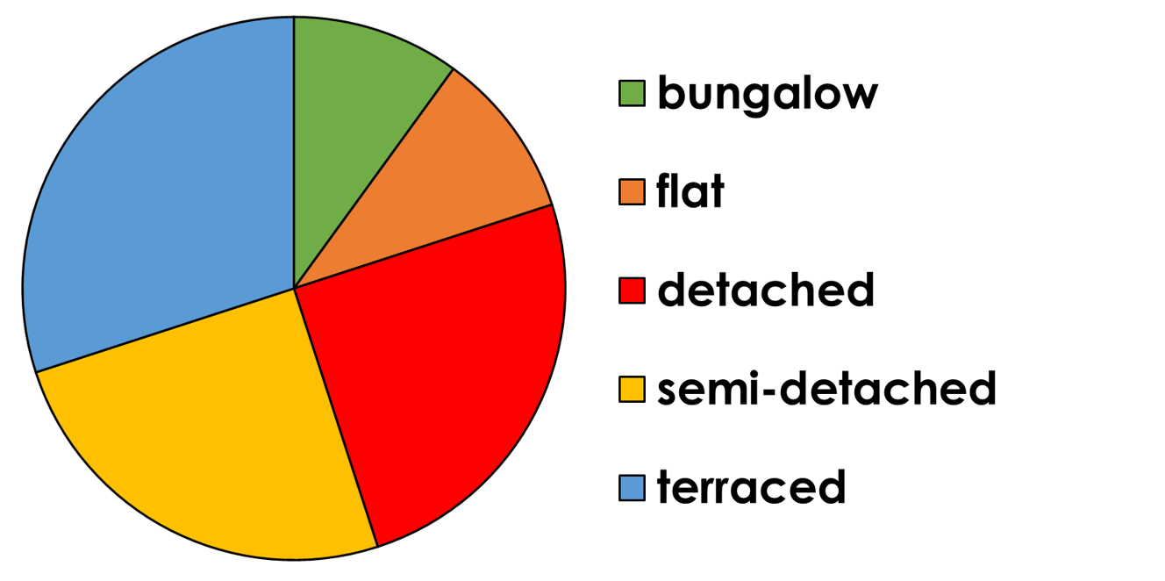
Pie chart 4:
This pie chart shows the types of houses the children in Year 6 live in.
1. Which house type is the most common?
2. 60 children took part in this survey. How many of them live in detached houses?
3. What fraction of children live in terraced houses?
4. How many fewer children live in bungalows than detached houses?
5. What percentage of children do NOT live in terraced houses or bungalows?

Slide 28
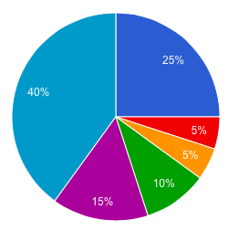

Pie chart 5:
This pie chart shows the favourite genre of books of 100 children.
1. Which genre is the most popular?
2. How many children chose fantasy?
3. True or false: more than a third of children chose graphic novels, mystery and comedy.
4. Approximately, what percentage of children chose sci-fi?
5. Approximately, how many children did NOT choose horror or comedy?
Fantasy
Sci-fi
Comedy
Mystery
Graphic novels
Horror

Slide 29
Pie charts (answers)
 | Pie charts 1 | Pie charts 2 | Pie charts 3 | Pie charts 4 | Pie charts 5
Q1 | Summer | Dog | Apples | Terraced | Horror
Q2 | 30 | No pet | 10 | 15 | 25
Q3 | 45 | 20 | 1/8 | 3/5 | False
Q4 | 12.5% | 1/4 | False | 9 | Approx. 10%
Q5 | 105 | Approx. 20 | Approx. 37.5% | Approx. 37.5% | Approx. 50

Slide 30
Reading and interpreting tables

Slide 31
This graph shows the amount of rainfall over a week.
1. On which day did it rain the most?
2. Which day did it rain the least?
3. How much more did it rain on Tuesday than Monday?
4. What is the difference between the wettest and driest day?
5. What is the mean rainfall over the 5 days?

Slide 32
This graph shows the amount of rainfall over a week.
1. On which day did it rain the most?
2. Which day did it rain the least?
3. How much more did it rain on Tuesday than Monday?
4. What is the difference between the wettest and driest day?
5. What is the mean rainfall over the 5 days?

Slide 33
This graph shows the amount of rainfall over a week.
1. On which day did it rain the most?
2. Which day did it rain the least?
3. How much more did it rain on Tuesday than Monday?
4. What is the difference between the wettest and driest day?
5. What is the mean rainfall over the 5 days?

Slide 34
This graph shows the amount of rainfall over a week.
1. On which day did it rain the most?
2. Which day did it rain the least?
3. How much more did it rain on Tuesday than Monday?
4. What is the difference between the wettest and driest day?
5. What is the mean rainfall over the 5 days?

Slide 35
This graph shows the amount of rainfall over a week.
1. On which day did it rain the most?
2. Which day did it rain the least?
3. How much more did it rain on Tuesday than Monday?
4. What is the difference between the wettest and driest day?
5. What is the mean rainfall over the 5 days?

