Slide 1
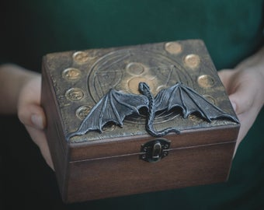
You find this box. You decide to open it…
Write about what happens when you open the box.

Slide 2

You wake up and realise you are in someone else’s body…
Write about your day. Who are you? What do you do? Where do you go? How do you get back to being you again? How do you feel about being someone else?

Slide 3
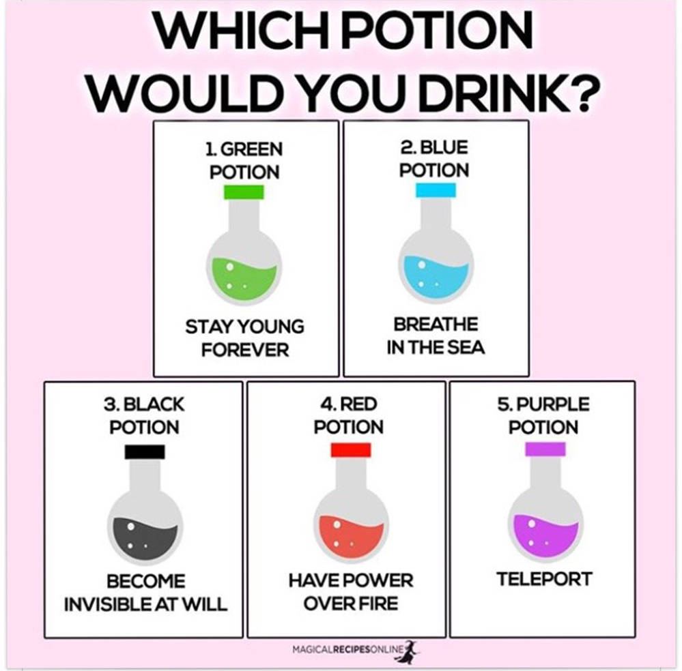
You can drink one potion, and one potion only…
Write about what happens when you drink the potion. You can write no less than 100 words.

Slide 4
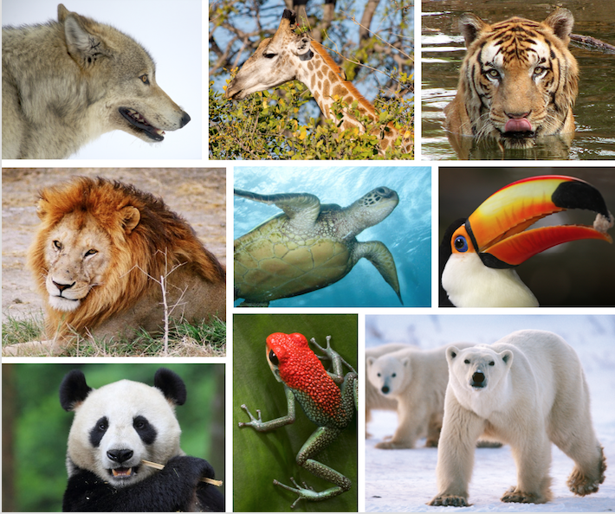
Imagine you are an animal…
Write about your day. What are you? What do you do with your day? Where do you go? What’s it like being you? What kind of animal are you? How do the other animals see you?

Slide 5
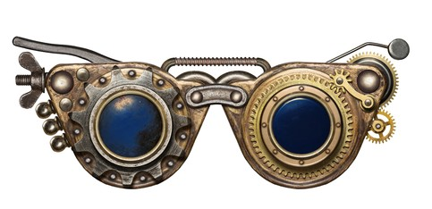
You find this pair of glasses. You decide to put them on…
Write about what happens when you put them on. You must write at least 100 words.

Slide 6
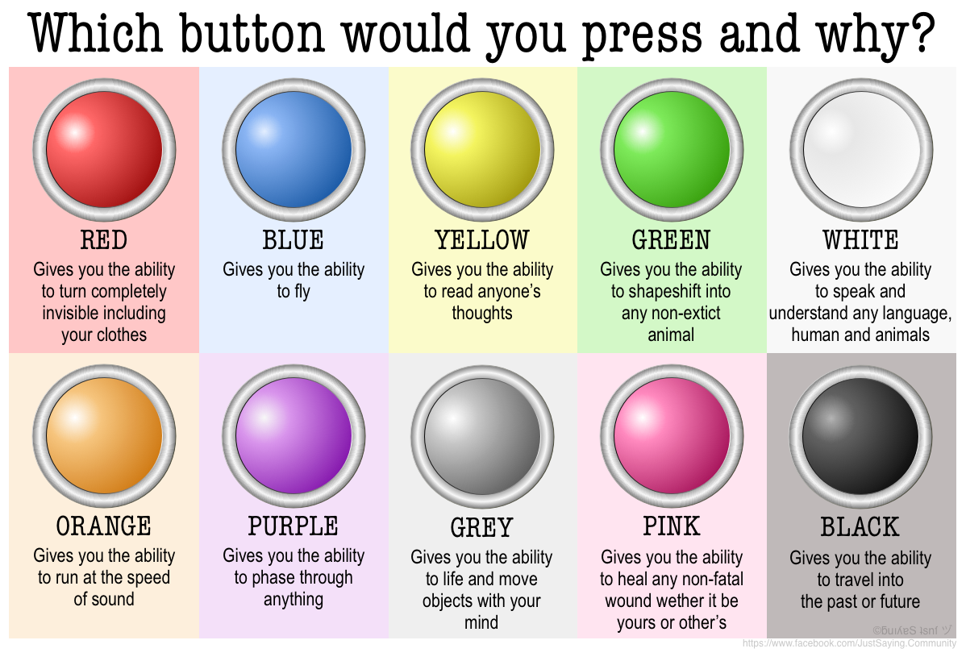
You find this set of buttons and are told you can press one and only one…
Write about which one you press, why you’ve pressed it and what happens when you do! You must write at least 100 words.

Slide 7
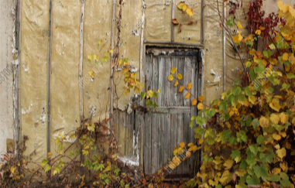
Imagine you walk through this door…
Write about what happens when you step through the door. Where do you end up? What do you see? Who do you meet? Do you like it there? You must write at least 100 words.

Slide 8
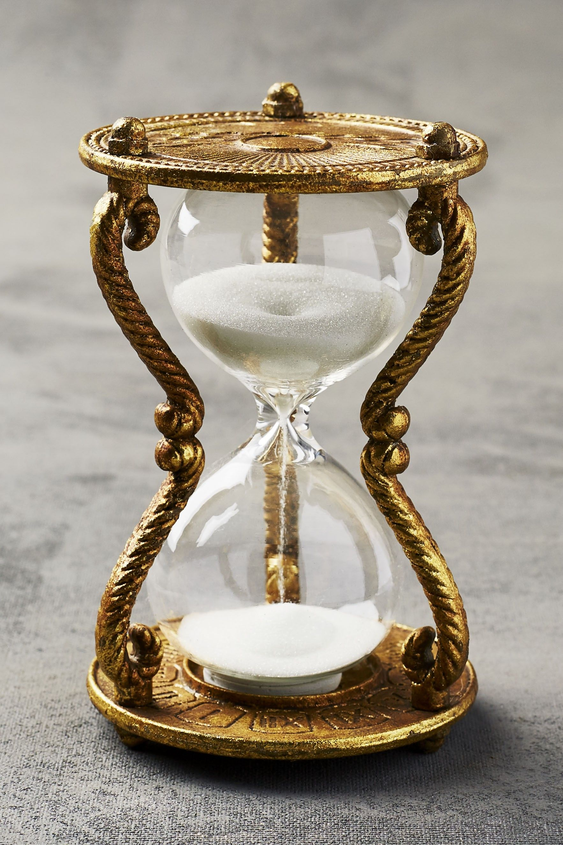
This sand timer can take you back in time to any period…
You flip over the sand timer and it takes you back to a period of history. Where do you go? Why do you go there? What are you going to learn? You must write at least 100 words.

Slide 9

Imagine finding an unaddressed letter…
You open the letter.
What does it say? Who is it for? How does it make you feel? What do you do with it once you’ve read it?

