Slide 1






If you have everything you need, while you wait, unscramble these Maths words: (the letter in bold is the first letter)
1. ddanioit
2. trsuabtconi
3. lmutilpiacnoit
4. vidnisoin
5. queinltyai
6. viidors
7. mevoul
8. eara
For this lesson, you will need:
Remember:
Microphone off unless instructed to turn it on
Use the chat function properly – no text speak/slang.
Use the ‘Raise Hand’ icon on Teams if you have/want to answer a question.

Slide 2
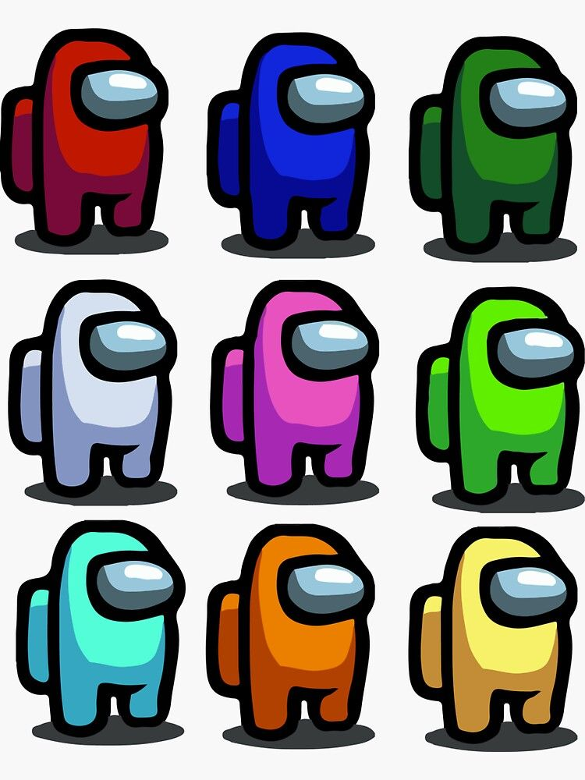
Are you ready to find the imposters?

Slide 3

A quarter of 60
Half of 30
Who is the imposter?
A third of 75
One tenth of 150
A third of 75

Slide 4
Two thirds of 30
A fifth of 100
Who is the imposter?
Three quarters of 40
Four fifths of 25
Three quarters of 40

Slide 5
950 + 137
512 + 575
Who is the imposter?
640 + 407
1,000 + 87
640 + 407

Slide 6
34, 826 + 28, 295
19,840 + 43, 282
19,840 + 43, 282
Who is the imposter?
24, 893 + 38,228
11,983 + 51,138

Slide 7
568 ÷ 7
355 ÷ 5
568 ÷ 7
Who is the imposter?
639 ÷ 9
213 ÷ 3

Slide 8

To finish…
any questions
or
any problems?

